Slide 1
Chapter 1: Introduction and System Structures
Notes:
1

Slide 2
Operating-System Structures
Operating System Services
User Operating System Interface
System Calls
Types of System Calls
Notes:
2

Slide 3
Operating System Services
Operating systems provide an environment for execution of programs and services to programs and users
One set of operating-system services provides functions that are helpful to the user:
User interface - Almost all operating systems have a user interface (UI).
Varies between Command-Line (CLI), Graphics User Interface (GUI), Batch
Program execution - The system must be able to load a program into memory and to run that program, end execution, either normally or abnormally (indicating error)
I/O operations - A running program may require I/O, which may involve a file or an I/O device
File-system manipulation - The file system is of particular interest. Programs need to read and write files and directories, create and delete them, search them, list file Information, permission management.
Notes:
3

Slide 4
Operating System Services (Cont.)
Communications – Processes may exchange information, on the same computer or between computers over a network
Communications may be via shared memory or through message passing (packets moved by the OS)
Error detection – OS needs to be constantly aware of possible errors
May occur in the CPU and memory hardware, in I/O devices, in user program
For each type of error, OS should take the appropriate action to ensure correct and consistent computing
Debugging facilities can greatly enhance the user’s and programmer’s abilities to efficiently use the system
Notes:
4

Slide 5
Operating System Services (Cont.)
Another set of OS functions exists for ensuring the efficient operation of the system itself via resource sharing
Resource allocation - When multiple users or multiple jobs running concurrently, resources must be allocated to each of them
Many types of resources - Some (such as CPU cycles, main memory, and file storage) may have special allocation code, others (such as I/O devices) may have general request and release code
Accounting - To keep track of which users use how much and what kinds of computer resources
Protection and security - The owners of information stored in a multiuser or networked computer system may want to control use of that information, concurrent processes should not interfere with each other
Protection involves ensuring that all access to system resources is controlled
Security of the system from outsiders requires user authentication, extends to defending external I/O devices from invalid access attempts
If a system is to be protected and secure, precautions must be instituted throughout it. A chain is only as strong as its weakest link.
Notes:
5

Slide 6
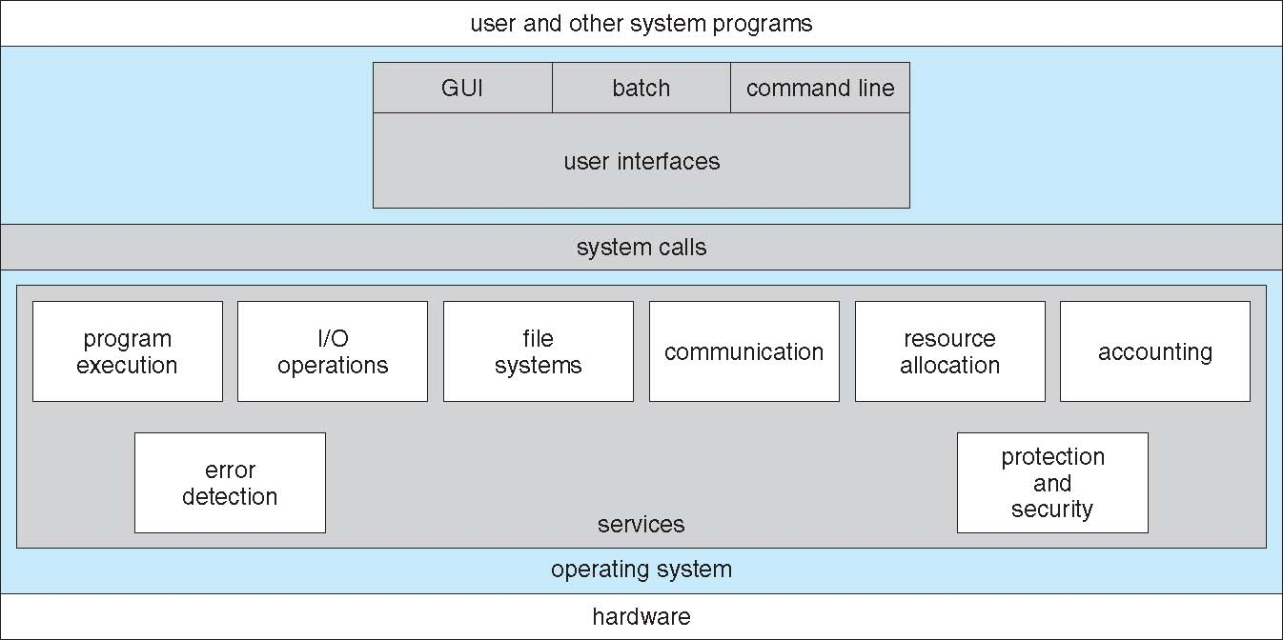
A View of Operating System Services

Slide 7
User Operating System Interface - CLI
Command Line Interface (CLI) or command interpreter allows direct command entry
Sometimes implemented in kernel, sometimes by systems program
Sometimes multiple flavors implemented – shells
Primarily fetches a command from user and executes it
Sometimes commands built-in, sometimes just names of programs
If the latter, adding new features doesn’t require shell modification
Notes:
7

Slide 8
User Operating System Interface - GUI
User-friendly desktop metaphor interface
Usually mouse, keyboard, and monitor
Icons represent files, programs, actions, etc
Various mouse buttons over objects in the interface cause various actions (provide information, options, execute function, open directory (known as a folder)
Invented at Xerox PARC
Many systems now include both CLI and GUI interfaces
Microsoft Windows is GUI with CLI “command” shell
Apple Mac OS X as “Aqua” GUI interface with UNIX kernel underneath and shells available
Solaris is CLI with optional GUI interfaces (Java Desktop, KDE)
Notes:
8

Slide 9
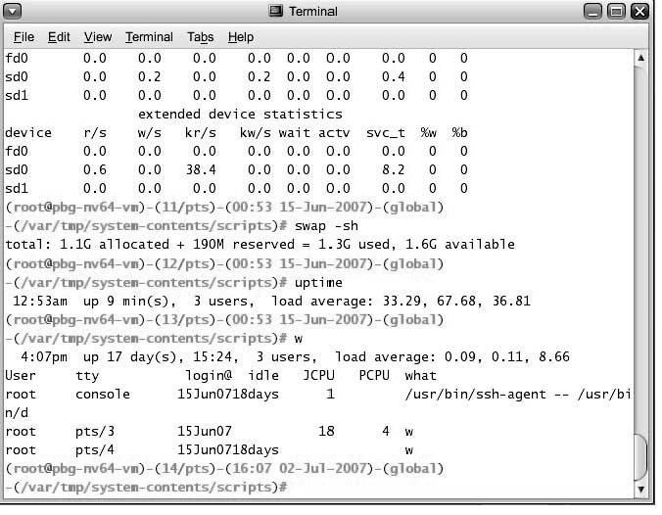
Bourne Shell Command Interpreter

Slide 10
System Calls
Programming interface to the services provided by the OS
Typically written in a high-level language (C or C++)
Mostly accessed by programs via a high-level Application Program Interface (API) rather than direct system call use
Three most common APIs are Win32 API for Windows, POSIX API for POSIX-based systems (including virtually all versions of UNIX, Linux, and Mac OS X), and Java API for the Java virtual machine (JVM)
Why use APIs rather than system calls?
(Note that the system-call names used throughout this text are generic)
Notes:
10

Slide 11
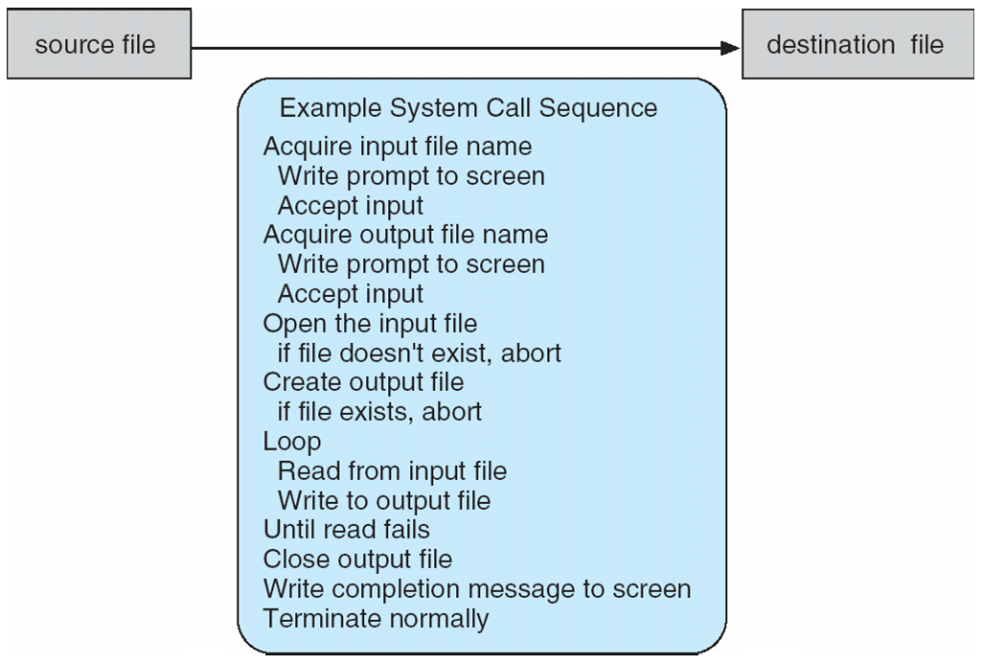
Example of System Calls
System call sequence to copy the contents of one file to another file
Notes:
11

Slide 12
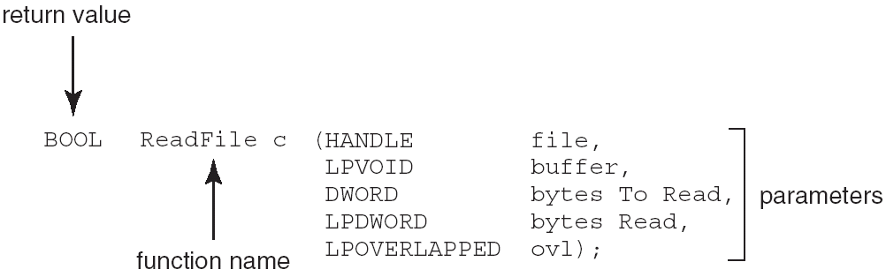
Example of Standard API
Consider the ReadFile() function in the
Win32 API—a function for reading from a file
A description of the parameters passed to ReadFile()
HANDLE file—the file to be read
LPVOID buffer—a buffer where the data will be read into and written from
DWORD bytesToRead—the number of bytes to be read into the buffer
LPDWORD bytesRead—the number of bytes read during the last read
LPOVERLAPPED ovl—indicates if overlapped I/O is being used
Notes:
12

Slide 13
System Call Implementation
Typically, a number associated with each system call
System-call interface maintains a table indexed according to these numbers
The system call interface invokes intended system call in OS kernel and returns status of the system call and any return values
The caller need know nothing about how the system call is implemented
Just needs to obey API and understand what OS will do as a result call
Most details of OS interface hidden from programmer by API
Managed by run-time support library (set of functions built into libraries included with compiler)
Notes:
13

Slide 14
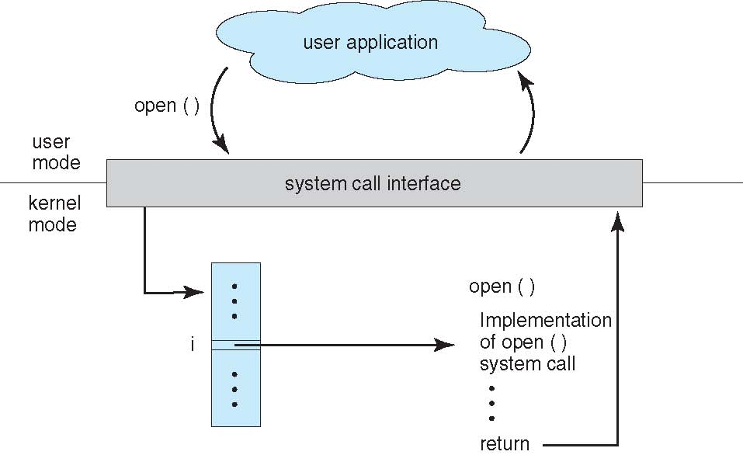
API – System Call – OS Relationship
Notes:
14

Slide 15
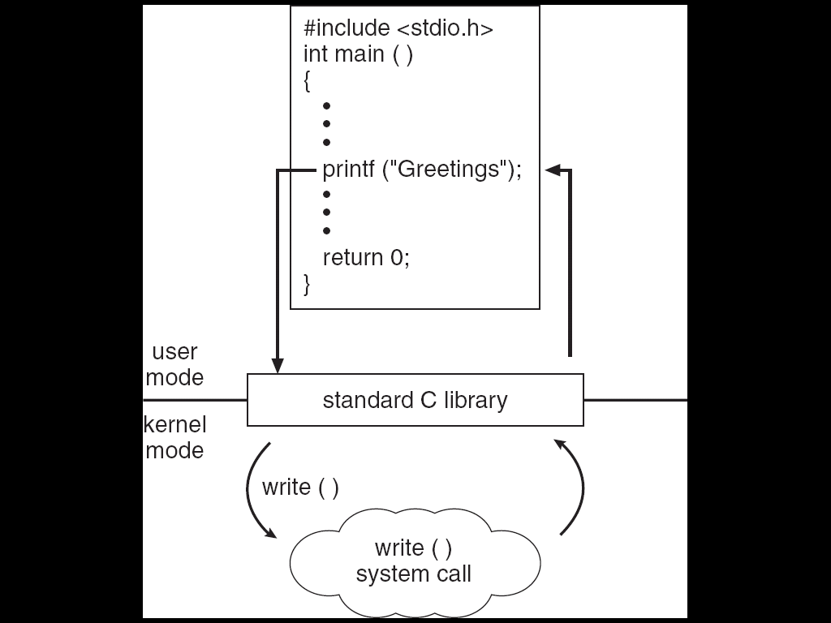
Standard C Library Example
C program invoking printf() library call, which calls write() system call
Notes:
15

Slide 16
System Call Parameter Passing
Often, more information is required than simply identity of desired system call
Exact type and amount of information vary according to OS and call
Three general methods used to pass parameters to the OS
Simplest: pass the parameters in registers
In some cases, may be more parameters than registers
Parameters stored in a block, or table, in memory, and address of block passed as a parameter in a register
This approach taken by Linux and Solaris
Parameters placed, or pushed, onto the stack by the program and popped off the stack by the operating system
Block and stack methods do not limit the number or length of parameters being passed
Notes:
16

Slide 17
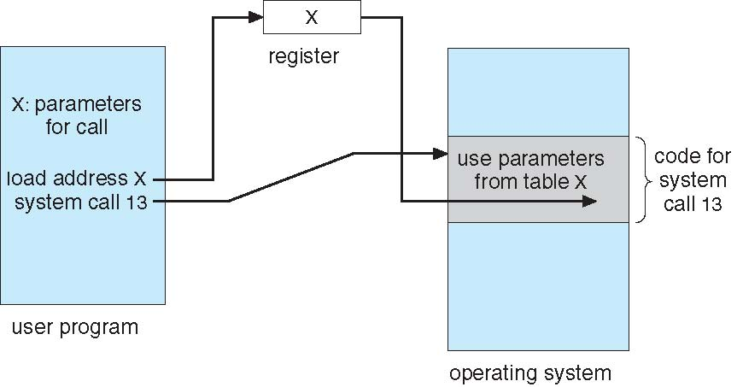
Parameter Passing via Table
Notes:
17

Slide 18
Types of System Calls
Process control
end, abort
load, execute
create process, terminate process
get process attributes, set process attributes
wait for time
wait event, signal event
allocate and free memory
File management
create file, delete file
open, close file
read, write, reposition
get and set file attributes
Notes:
18

Slide 19
Types of System Calls (Cont.)
Device management
request device, release device
read, write, reposition
get device attributes, set device attributes
logically attach or detach devices
Information maintenance
get time or date, set time or date
get system data, set system data
get and set process, file, or device attributes
Communications
create, delete communication connection
send, receive messages
transfer status information
attach and detach remote devices
Notes:
19

Slide 20
System Services
System programs provide a convenient environment for program development and execution. They can be divided into:
File manipulation
Status information sometimes stored in a file
Programming language support
Program loading and execution
Communications
Background services
Application programs
Most users’ view of the operating system is defined by system programs, not the actual system calls

Slide 21
System Services
System programs provide a convenient environment for program development and execution. They can be divided into:
File manipulation
Status information sometimes stored in a file
Programming language support
Program loading and execution
Communications
Background services
Application programs
Most users’ view of the operating system is defined by system programs, not the actual system calls

Slide 22
System Services (Cont.)
File modification
Text editors to create and modify files
Special commands to search contents of files or perform transformations of the text
Programming-language support - Compilers, assemblers, debuggers and interpreters sometimes provided
Program loading and execution- Absolute loaders, relocatable loaders, linkage editors, and overlay-loaders, debugging systems for higher-level and machine language
Communications - Provide the mechanism for creating virtual connections among processes, users, and computer systems
Allow users to send messages to one another’s screens, browse web pages, send electronic-mail messages, log in remotely, transfer files from one machine to another

Slide 23
System Services (Cont.)
Background Services
Launch at boot time
Some for system startup, then terminate
Some from system boot to shutdown
Provide facilities like disk checking, process scheduling, error logging, printing
Run in user context not kernel context
Known as services, subsystems, daemons
Application programs
Don’t pertain to system
Run by users
Not typically considered part of OS
Launched by command line, mouse click, finger poke

Slide 24
Linkers and Loaders
Source code compiled into object files designed to be loaded into any physical memory location – relocatable object file
Linker combines these into single binary executable file
Also brings in libraries
Program resides on secondary storage as binary executable
Must be brought into memory by loader to be executed
Relocation assigns final addresses to program parts and adjusts code and data in program to match those addresses
Modern general purpose systems don’t link libraries into executables
Rather, dynamically linked libraries (in Windows, DLLs) are loaded as needed, shared by all that use the same version of that same library (loaded once)
Object, executable files have standard formats, so operating system knows how to load and start them

Slide 25
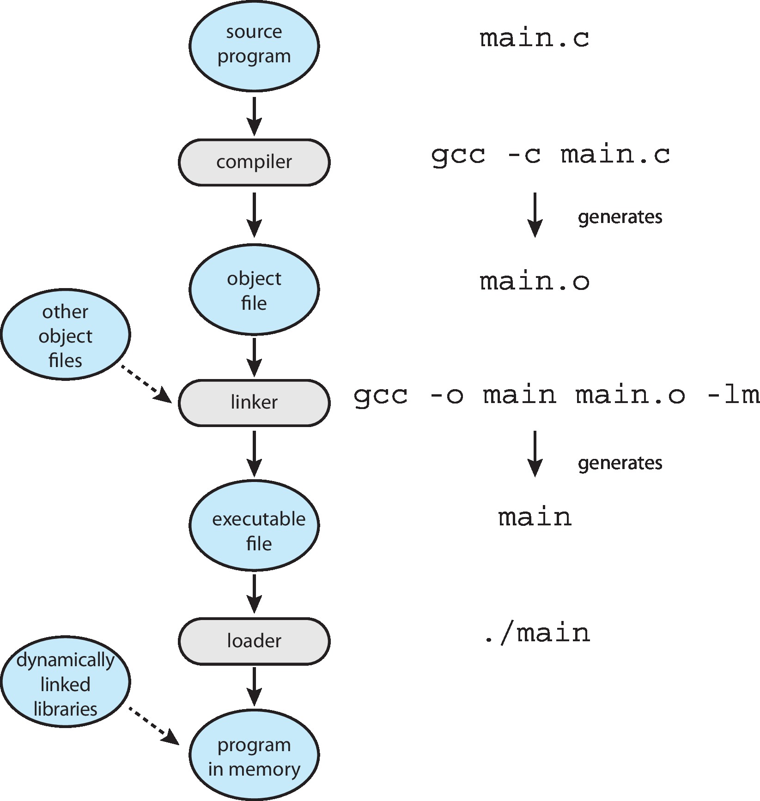
The Role of the Linker and Loader

Slide 26
THANK YOU

